Slide 1

Loosely-Coupled
Architecture
How to get rid of the domino effect

Slide 2


Slide 3


Slide 4


Radek Maziarka
objectivity.co.uk
radekmaziarka.pl
@RadekMaziarka

Slide 5
Loosely-Coupled Architecture
In 1 sentence
... is one in which each of its components has, or makes use of, little or no knowledge of the definitions of other separate components.

Slide 6

SHOULD
YOU
EVEN
CARE?

Slide 7
Technology changes so fast...

Slide 8










Slide 9
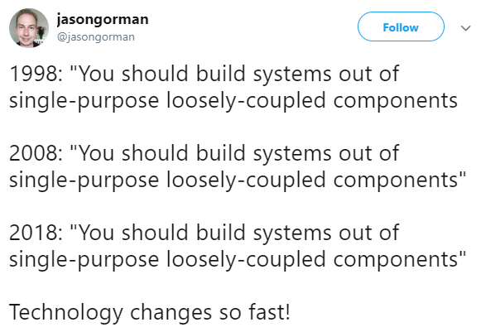

Slide 10

„A loosely coupled, well-encapsulated architecture drives IT performance.
In the 2017 dataset, this was the biggest contributor to continuous delivery.”

Slide 11
Architecture / deploys per developers
Based on “Accelerate – The science of Lean Software and DevOps”
HIGHLY
MODERATELY
LOOSELY

Slide 12
High number of deploys
Large scale changes
Better / faster scaling
Loosely-Coupled Architecture
Less coordination / communication
Testing on without E2E
Deploy during normal hours

Slide 13
What is
Loosely-Coupled Architecture?

Slide 14

Microservices

Slide 15



Slide 16
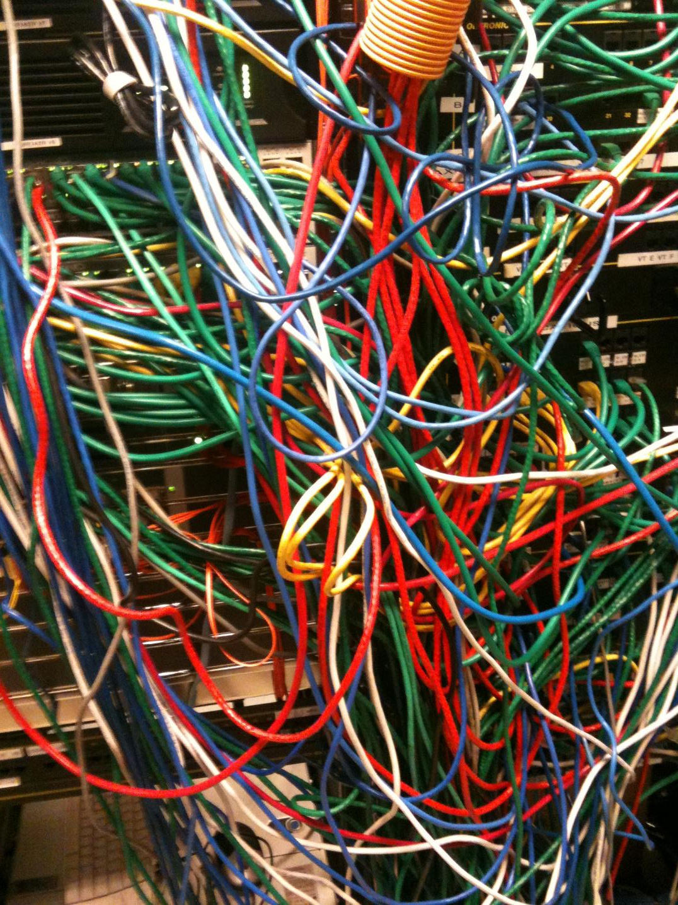
Microservices
Bad signs of not applying Loosely-Coupled Architecture
1
GLOBAL STATE OR INTEGRATION BY DATABASE
2
SERVICES ARE OVERLY CHATTY
3
KNOWLEDGE OF INTERNAL BEHAVIOR
4
DEPENDENT DEPLOYMENTS

Slide 17

Payroll department
Good example of Loosely-Coupled Architecture
1
SALARY INFORMATION NOT AVAILABLE OUTSIDE DEPARTMENT
2
YOU DON’T CHANGE YOUR OWN SALARY
3
ANNEX AS A FORM OF COMMUNICATION
4
NO SHARING ABOUT INTERNAL DETAILS

Slide 18
Loosely-Coupled Architecture
2 important factors which lead you to it
(High) Cohesion
(Low) Coupling

Slide 19
Low Cohesion
Measures of cohesion
SHARED
DATA ACCESS
ON INIT
Coincidental
Logical
Temporal
The only relationship between the parts is that they have been grouped together.
Parts are logically categorized to do the same thing even though they are different by nature.
Parts are grouped by when they are processed.
Coupling And Cohesion https://files-cdn.cnblogs.com/files/younggift/Cohesion&Coupling.pdf

Slide 20
High Cohesion
Measures of cohesion
BUILDER
ORDER MGMT.
PAYMENT CALCULATOR
Sequential
Informational
Functional
Output from one part is the input to another part like an assembly line.
Multiple functions represented by entry points deal with a single data structure.
Parts all contribute to a single well-defined task of the module.
Coupling And Cohesion https://files-cdn.cnblogs.com/files/younggift/Cohesion&Coupling.pdf

Slide 21
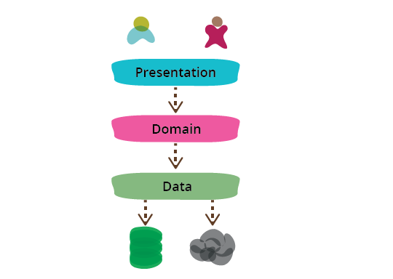
PresentationDomainDataLayering https://martinfowler.com/bliki/PresentationDomainDataLayering.html

Slide 22
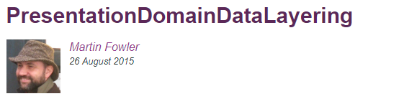


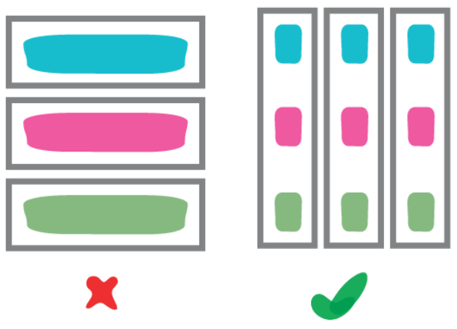
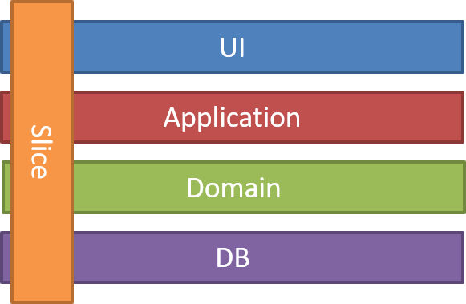
PresentationDomainDataLayering https://martinfowler.com/bliki/PresentationDomainDataLayering.html
Vertical Slice Architecture https://jimmybogard.com/vertical-slice-architecture/

Slide 23
Features, not slices
Better way of dividing modules
Controllers
Order
Payment
Delivery
Order
Payment
Delivery
Controllers
Controllers
Controllers
Domain
Domain
Domain
Domain
Order
Payment
Delivery
Database
Database
Database
Database
Order
Payment
Delivery

Slide 24
High Coupling
Measures of coupling
DB
DB
flag
1
2
1
2
1
2
Content
Common
Control
One module modifies or relies on the internal workings of another module (e.g. data, logic).
Two modules share the same global data.
One module controlling the flow of another, by passing it information on what to do.
Coupling And Cohesion https://files-cdn.cnblogs.com/files/younggift/Cohesion&Coupling.pdf

Slide 25
Low Coupling
Measures of coupling
Message Bus
ID
1
2
1
2
1
2
Data
Data
Message
No
One module modifies or relies on the internal workings of another module (e.g. data, logic).
Modules use a public interface to exchange parameter-less messages.
Modules do not communicate at all with one another.
Coupling And Cohesion https://files-cdn.cnblogs.com/files/younggift/Cohesion&Coupling.pdf

Slide 26

Microservices
Good signs of not applying Loosely-Coupled Architecture
1
INTEGRATION BY WELL KNOWN API
2
NO SHARING INTERNAL INFO
3
CONTRACT TESTS
4
MICROSERVICE CAN LIVE ON ITS OWN

Slide 27
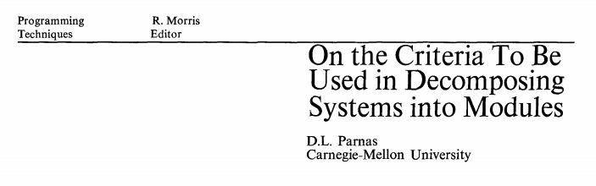
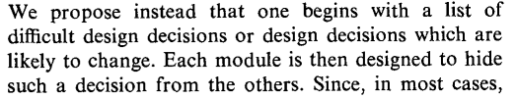

Slide 28
Lease application
Modules in system to lease cars
CONFIG
LEASE
PAYMENTS
INVOICES
LEGAL

Slide 29
Lease application
Modules in system to lease cars and computers
CONFIG
LEASE
PAYMENTS
INVOICES
LEGAL
CAR
CAR
CAR
CAR
CAR
COMPUTER
COMPUTER
COMPUTER
COMPUTER
COMPUTER

Slide 30


Slide 31
Lease application
Modules in system to lease cars and computers
CONFIG
LEASE
PAYMENTS
INVOICES
LEGAL
CAR
CAR
CAR
CAR
CAR
COMPUTER
COMPUTER
COMPUTER
COMPUTER
COMPUTER

Slide 32
Lease application
Modules in system to lease cars and computers
CAR
CONFIG
LEASE
PAYMENTS
INVOICES
LEGAL
COMPUTER
CONFIG
LEASE
PAYMENTS
INVOICES
LEGAL

Slide 33
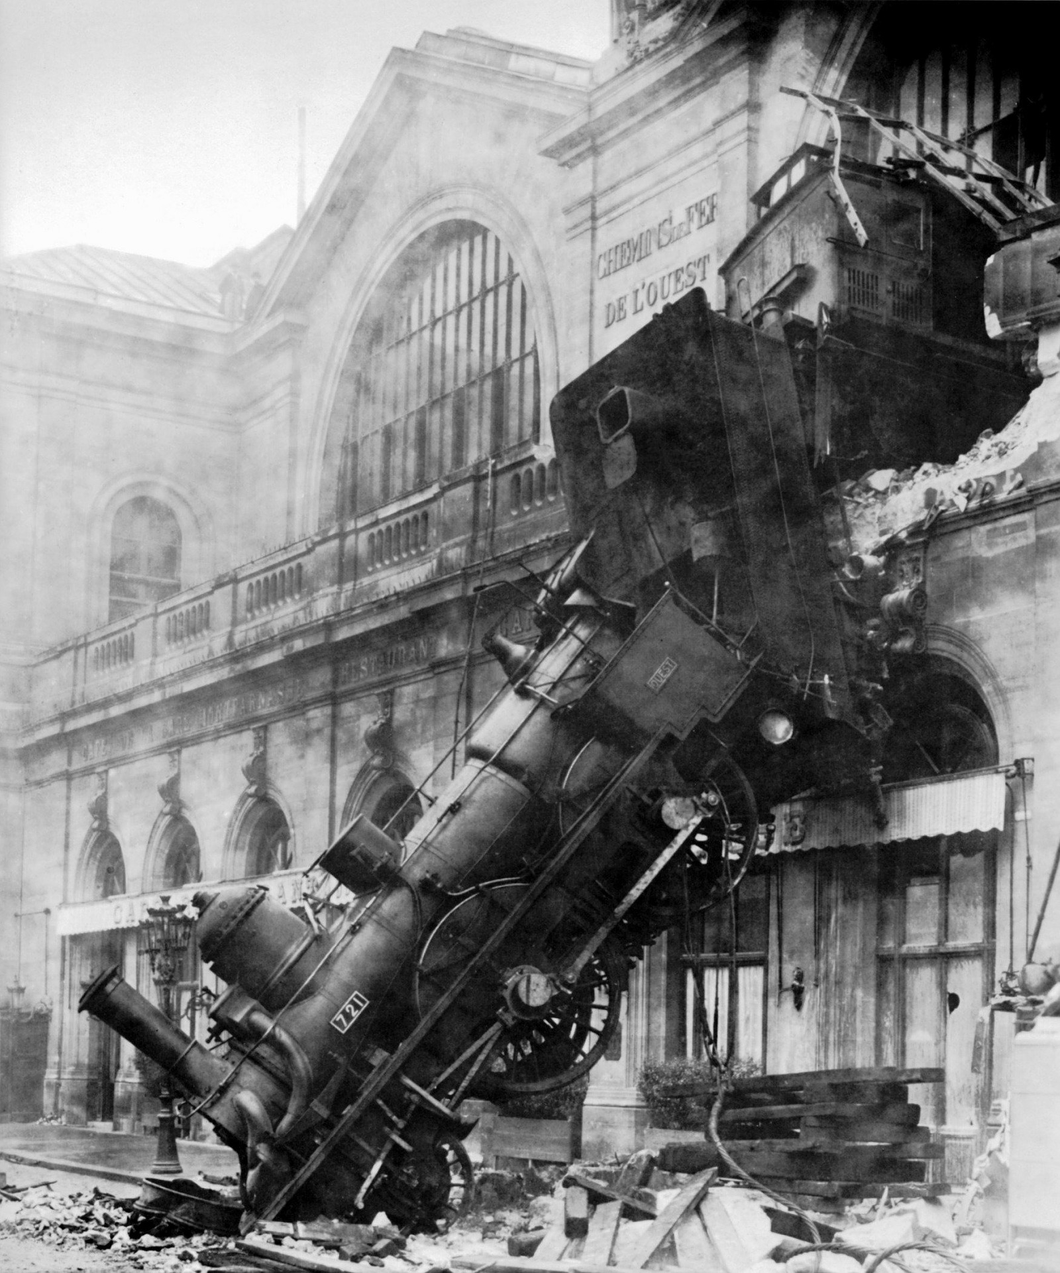
HOW
TO
FAIL?

Slide 34
Don’t Repeat Yourself
Every piece of knowledge must have a single, unambiguous, authoritative representation within a system.

Slide 35
Cost of a new feature
Comparision between DRY and not-DRY
DRY
not-DRY
A
A
X
FUN
FUN
B
X
B
X
FUN
FUN
C
C
X
FUN

Slide 36
Cost of new different features
Comparision between DRY and noT-DRY
DRY
not-DRY
A
A
X
FUN
B
?
B
Y
FUN
FUN
C
C
Z
FUN

Slide 37
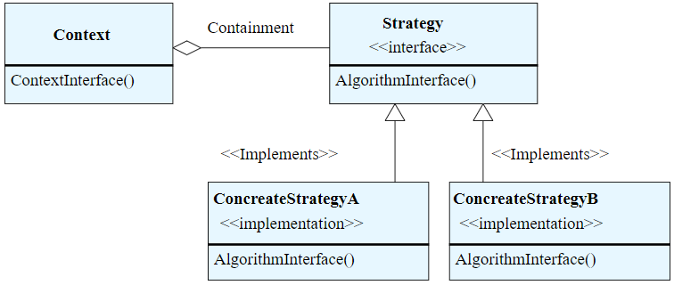


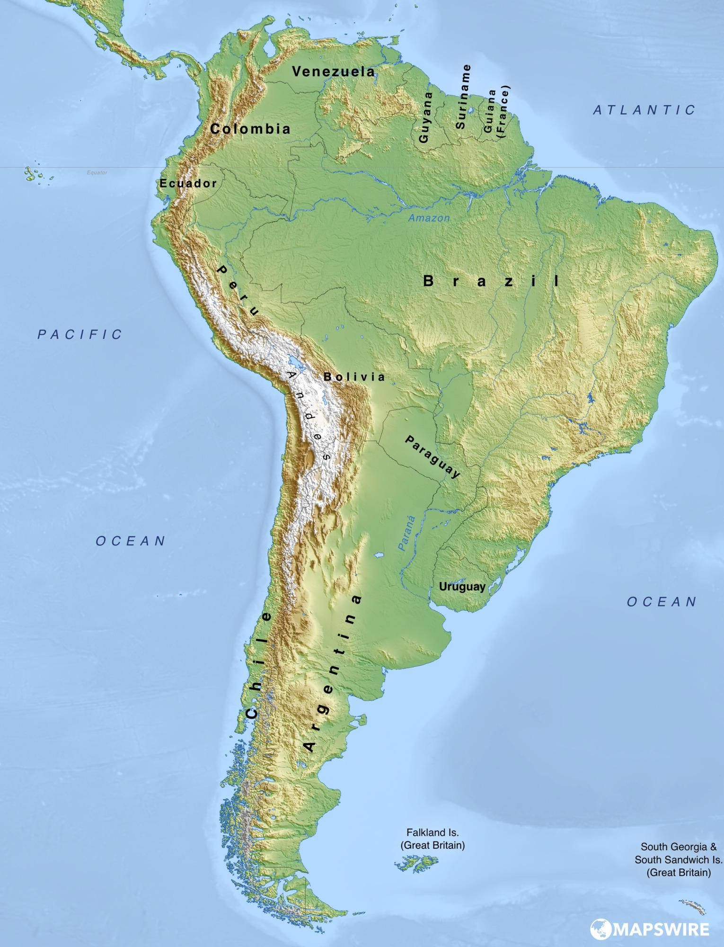
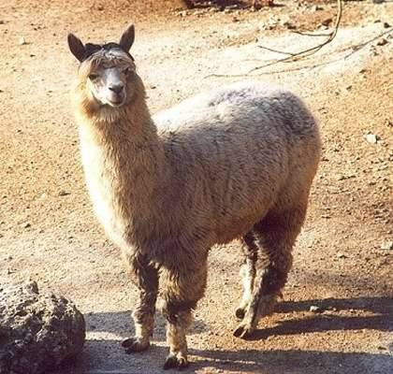

Unit.net

Slide 38
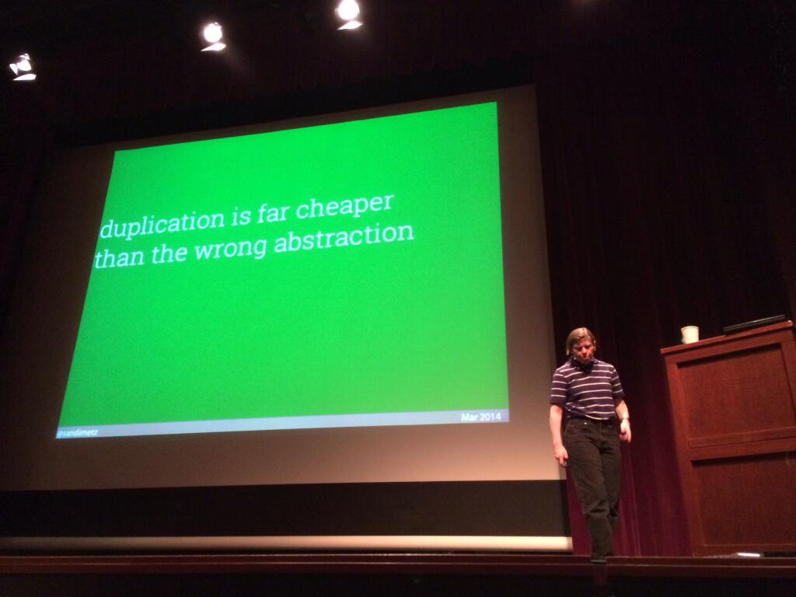
RailsConf 2014 - All the Little Things by Sandi Metz https://www.youtube.com/watch?v=8bZh5LMaSmE

Slide 39
Real example – notes
Implementational differences within single context
PRODUCT
ORDER
DELIVERY
USER MGMT
PAYROLL
NOTES

Slide 40
Don’t Repeat Yourself
Every piece of knowledge must have a single, unambiguous, authoritative representation within a system.

Slide 41

HOW
TO
ACHIEVE
IT?

Slide 42


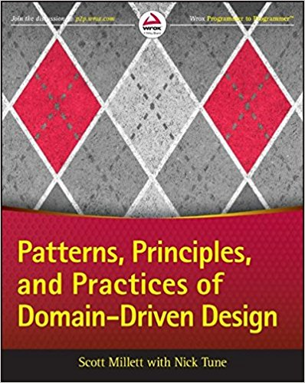
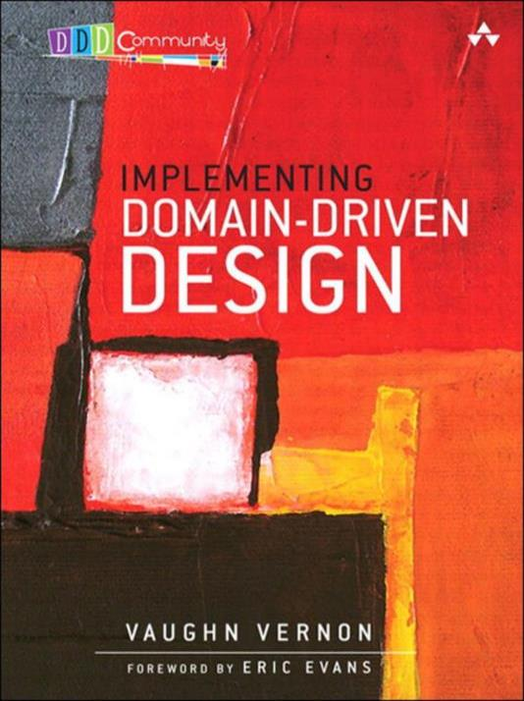
DOMAIN
DRIVEN
DESIGN

Slide 43
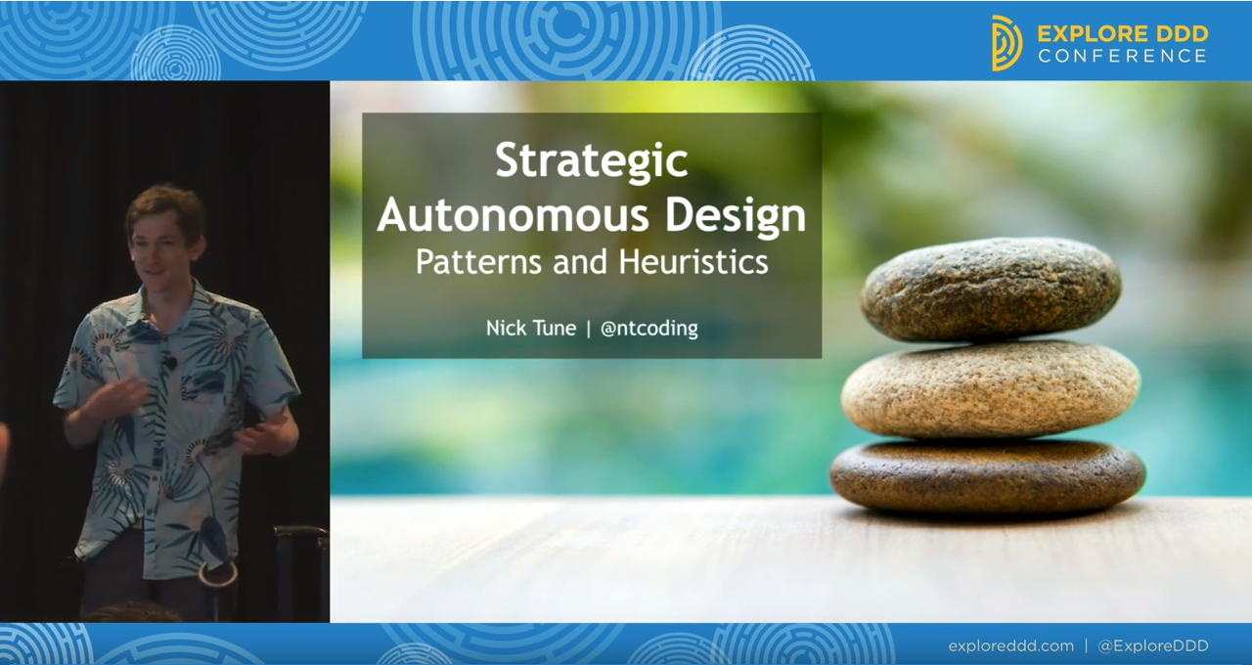
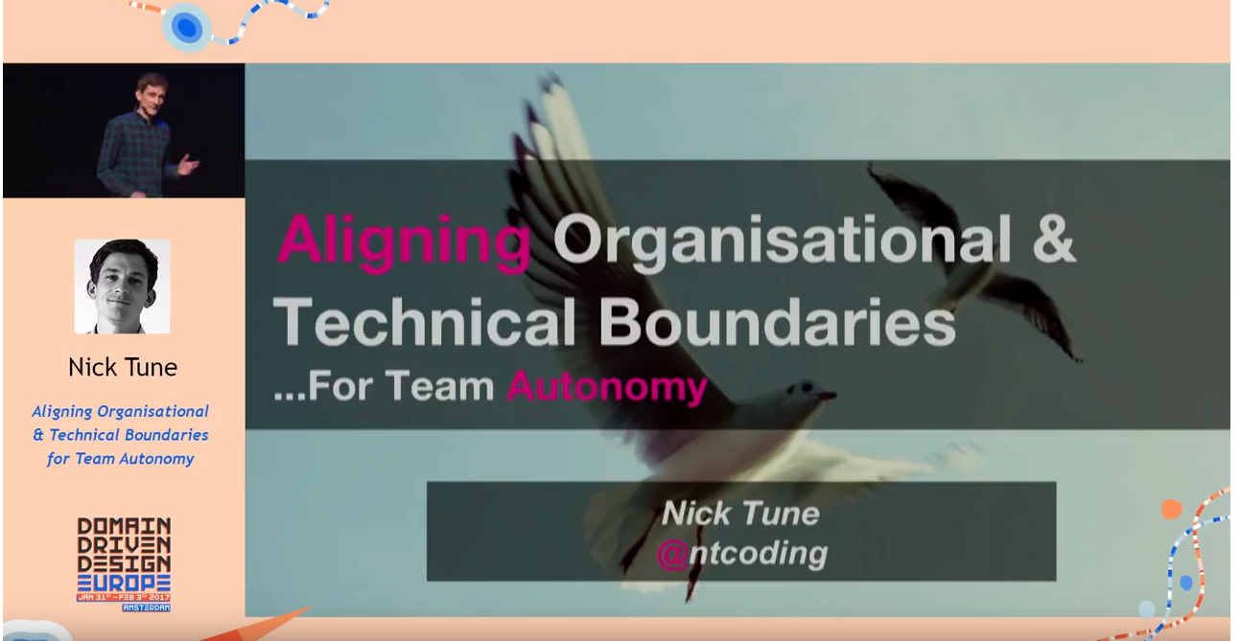

Notes:
-
- Każdy dział będzie
- Nie da się stworzyc jednorodnego modelu ponieważ rzeczywistość nie jest jednorodna.

Slide 44
How to split into modules?
Few examples of good division heuristic
1
DEPARTMENTS
4
DATA OWNERSHIPS
2
DOMAIN EXPERTS
5
USER EXPERIENCE
3
BUSINESS PROCESSESS
6
RATE OF CHANGE
Notes:
-
- Każdy dział będzie
- Nie da się stworzyc jednorodnego modelu ponieważ rzeczywistość nie jest jednorodna.

Slide 45
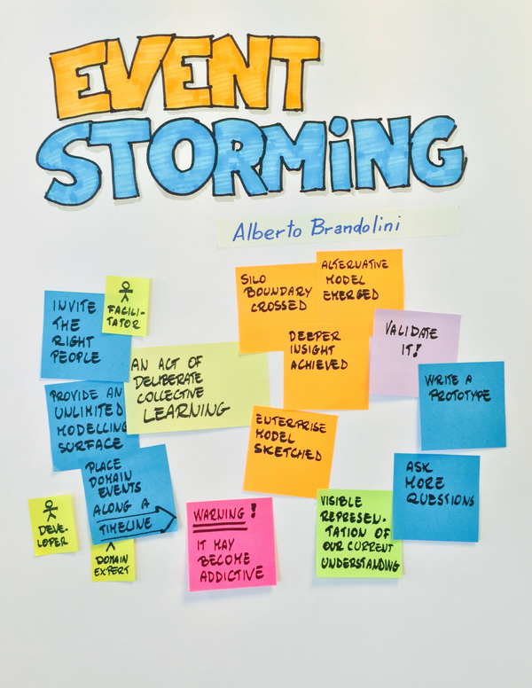
Event Storming
Workshops of Alberto Brandolini
Notes:
-
- Każdy dział będzie
- Nie da się stworzyc jednorodnego modelu ponieważ rzeczywistość nie jest jednorodna.

Slide 46
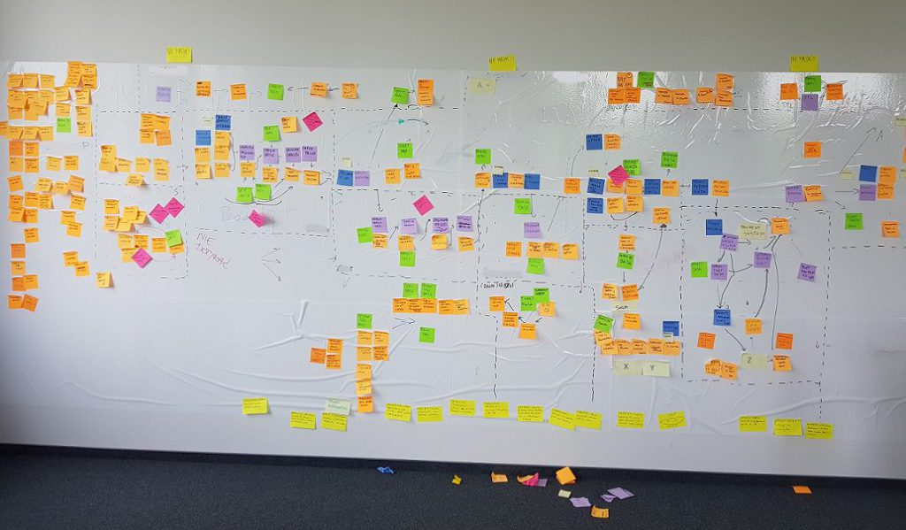
Event Storming - example
Workshops in Objectivity
Notes:
-
- Każdy dział będzie
- Nie da się stworzyc jednorodnego modelu ponieważ rzeczywistość nie jest jednorodna.

Slide 47
Context map
Store
Approaches of communications between contexts
Up
Down
Legacy Reporting
Layer
Separate Ways
Orders
Partnership
Shipping
Shared Kernel
Notifications

Slide 48


Slide 49
radekmaziarka.pl/loosely-coupled-architecture
Nicole Forsgren, Jez Humble, Gene Kim – Accelerate: The Science of Lean Software and DevOps
Simon Brown – Modular Monolith
Cohesion & Coupling
Martin Fowler – Presentation Domain Data Layering
Jimmy Bogard – Vertical Slice Architecture
David Parnas – On the Criteria To Be Used in Decomposing Systems into Modules
Sandi Metz -All the Little Things
Adam Brett – DRY (Don’t Repeat Yourself) is a Fallacy
Tef Books – Write code that is easy to delete, not easy to extend
Eric Evans – Domain Driven Design
Nick Tune -Tech Strategy Blog
Alberto Brandolini – Event Storming
Alberto Brandolini – Strategic Domain Driven Design with Context Mapping

Slide 50

radekmaziarka.pl/loosely-coupled-architecture
radekmaziarka.pl/form

